Slide 1
Large-scale Graph Mining with Spark
What I learned from mapping >15 million sites
Win Suen
PyGotham 2018

Slide 2
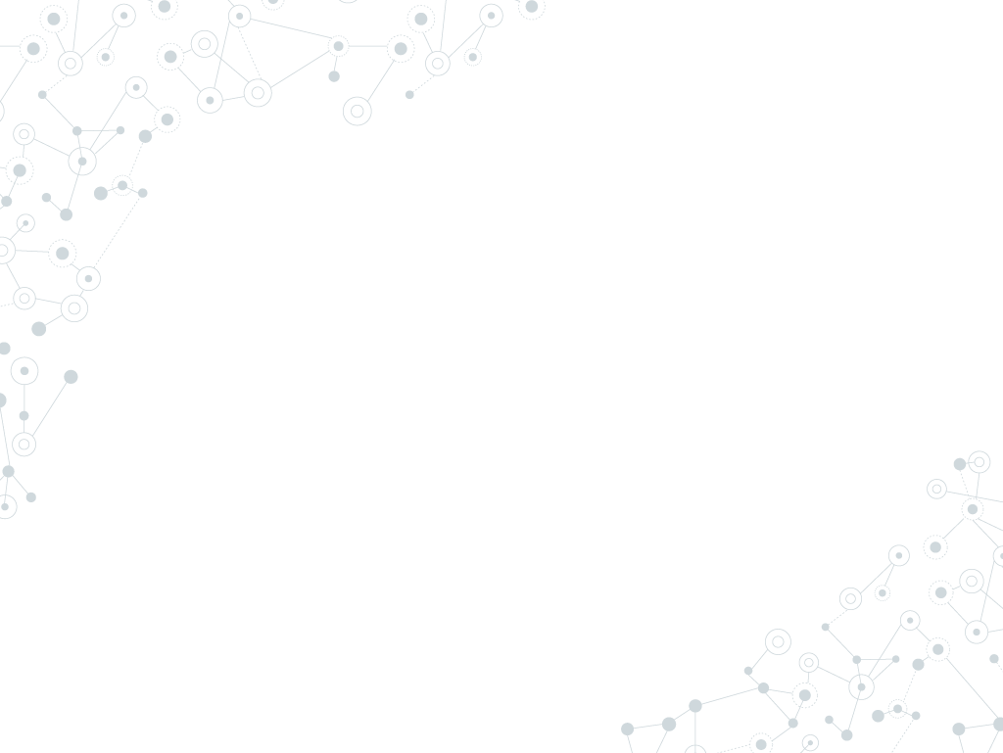

Hello!
I am Win Suen
Data Scientist @ AppNexus (now Xandr)
Avid hiker
Reader of books and papers

Slide 3
Agenda
Why?
Labelled data is not always available. Graphs let you find related objects without labels.
How?
Find clusters from underlying graph structure, using community detection.
What?
Detect similar sites in large web graph.
Discussion

Slide 4
Graphs 101

Slide 5
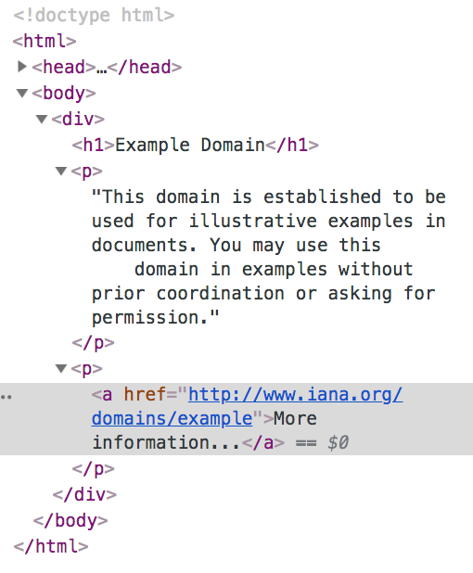
Web graphs
Node: example.com
Edge
Node: iana.org

Slide 6
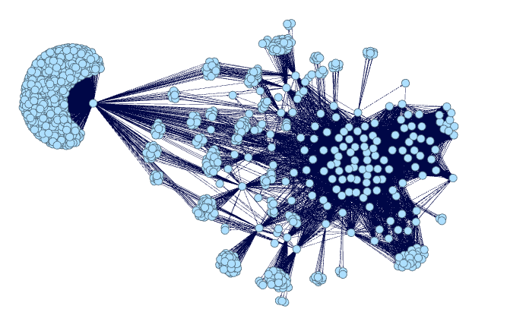
Web graphs: substructures
Subpage structure of a news site, generated by me using Gephi.

Slide 7
1.
Why graphs?

Slide 8
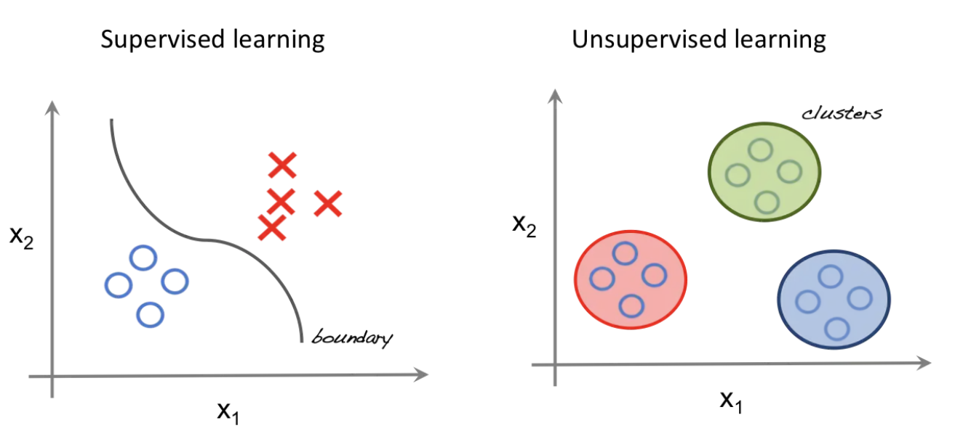
Look, ma! No labels!
http://beta.cambridgespark.com/courses/jpm/01-module.html

Slide 9
Why unsupervised learning?
Data isn’t free.
Labels not always available.
We may not know how many classes of things we are looking for.

Slide 10
Applications of clustering
Predicting class labels with no previous data
High-level groupings for audience segmentation, classification
Recommender for similar sites
Anomaly detection
Part of semi-supervised ensemble

Slide 11
How to do this with graphs? → Community detection!
Community
No unique definition.
Generally, substructure of a graph where nodes within structure are more densely connected to each other than nodes outside the substructure.
A community is a cluster!

Slide 12
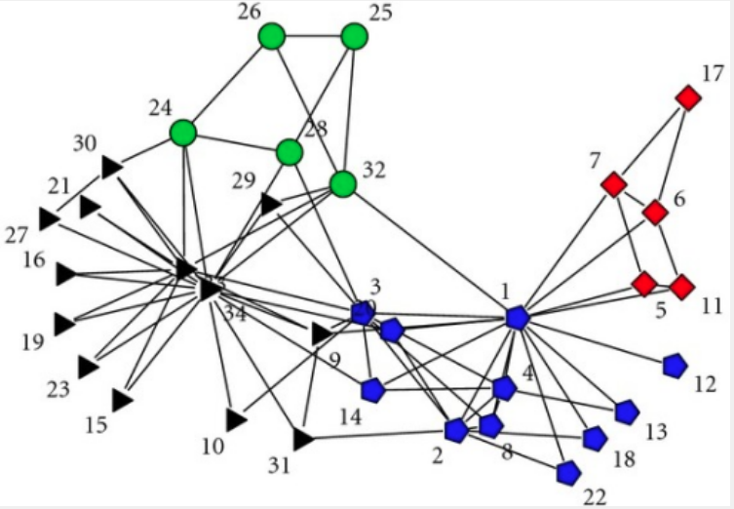
Communities
Image from: KONECT, April 2017.
Data from original study: Zachary, Wayne W. "An information flow model for conflict and fission in small groups." Journal of anthropological research33.4 (1977): 452-473.

Slide 13
Assumptions
Edges are not drawn at random!
Why?

Slide 14
Assumptions
Edges are not drawn at random!
Why?
Influence: “All my friends are doing it!”

Slide 15
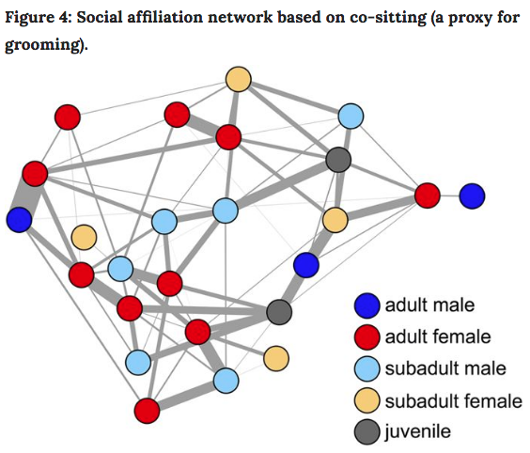
Influence
Farine, Damien R., et al. "Both nearest neighbours and long-term affiliates predict individual locations during collective movement in wild baboons." Scientific reports 6 (2016): 27704

Slide 16
Assumptions
Edges are not drawn at random!
Why?
Influence: “All my friends are doing it!”
Homophily: aka assortative mixing. “Birds of a feather flock together.”

Slide 17
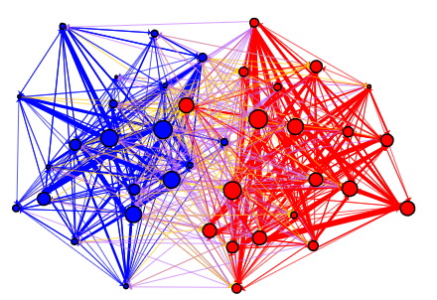
Homophily
Adamic, Lada A., and Natalie Glance. "The political blogosphere and the 2004 US election: divided they blog." Proceedings of the 3rd international workshop on Link discovery. ACM, 2005.

Slide 18
2.
Community Detection

Slide 19
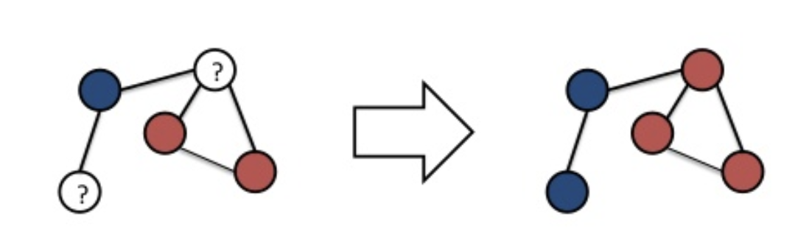
Label Propagation Algorithm (LPA)
Iterative approach. Labels (supervised) or cluster ids (unsupervised) “flow” through the graph.

Slide 20
LPA in action
Each node starts in its own community. For a given node x, C_{x}(0) = x.
Set t = 1.
Arrange the nodes in the network in a random order and set it to X.
For each x ∈ X chosen in that specific order , let C_{x} ( t ) = f ( C_{x i 1}( t ) , ... , C _{x i m} ( t ) , C _{x i ( m + 1 )} ( t − 1 ) , . . . , C _{x i k} ( t − 1 ) ). f returns the label occurring with the highest frequency among neighbors. Ties are broken randomly.
If every node has a label that the maximum number of their neighbors have, stop. Else, set t = t+1 and return to (3).
Raghavan, Usha Nandini, Réka Albert, and Soundar Kumara. "Near linear time algorithm to detect community structures in large-scale networks." Physical review E 76.3 (2007): 036106.

Slide 21
Advantages of LPA
Labels not required.
External parameter setting (iterations, number or size of clusters) is not necessary.
Runs in near linear time.
Produces interpretable results.

Slide 22
3. Code!

Slide 23
Why choose GraphFrames?
Processes data too large to fit on single machine.
Provides parallelism in processing.
Has some fault tolerance.
Integrates nicely with other python packages.

Slide 24
What I did
Clean Common Crawl dataset. Sample files, parse warc files, clean, extract links from html.
Load graph into Graphframe.
Filter, clean, repeat. Do this, a lot.
Try to detect communities.

Slide 25
What I‘ll talk about
Clean Common Crawl dataset. Sample files, write custom parser for warc files, extract links from html.
Load graph into Graphframe.
Filter, clean, repeat. Do this, a lot.
Try to detect communities.

Slide 26
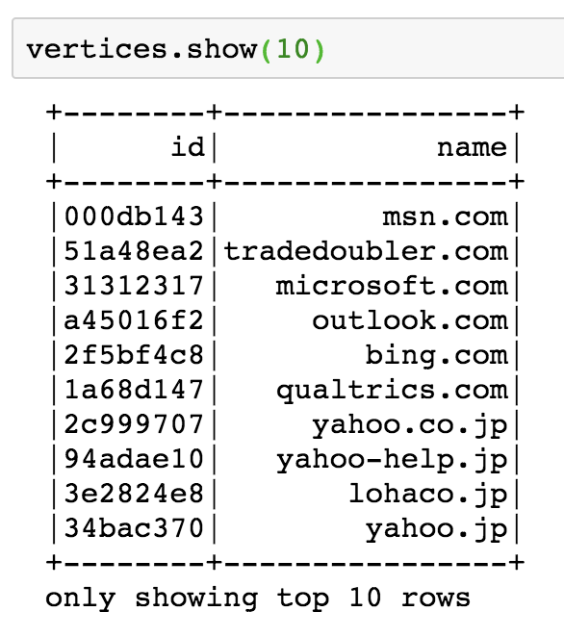
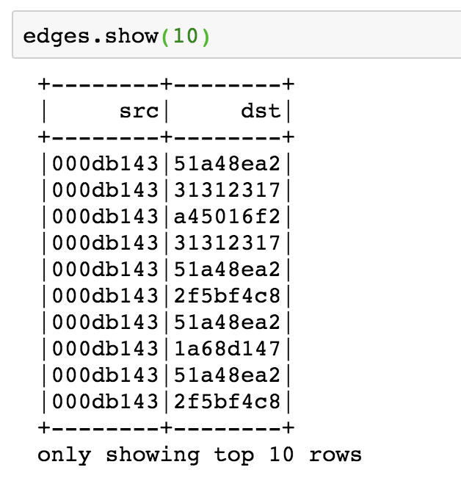
Create GraphFrame

Slide 27
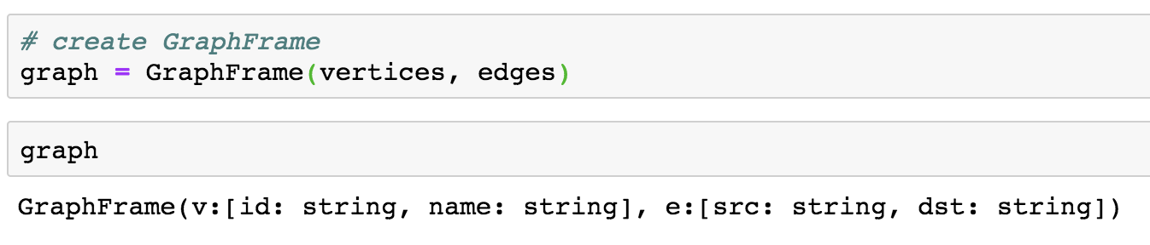
Create GraphFrame

Slide 28
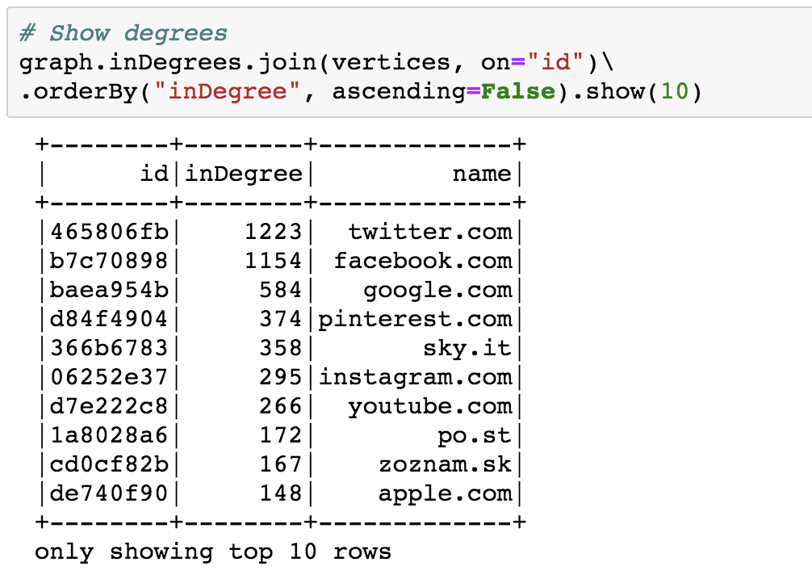
See top nodes

Slide 29
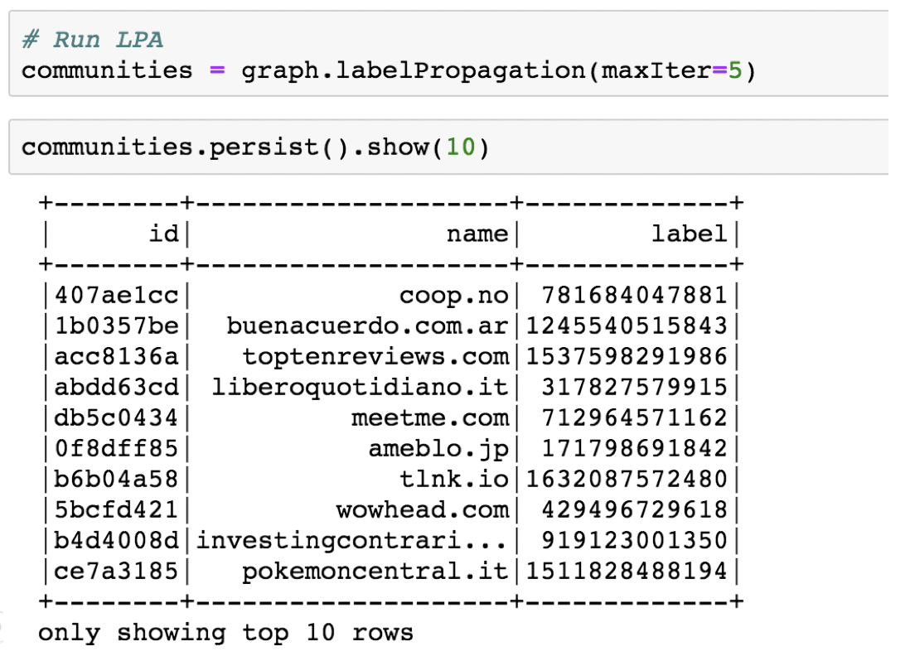
Run LPA

Slide 30
4. Results

Slide 31
> 15 million
4,782
3,573 sites
That’s a lot of nodes. Filter, clean, repeat.
Communities detected
Size of largest community

Slide 32
LPA converges around 5 iterations for sampled Common Crawl data.

Slide 33
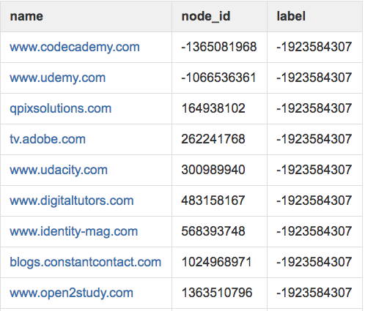
Community: online learning
Mixed community of online learning sites, sites that link to these sites

Slide 34
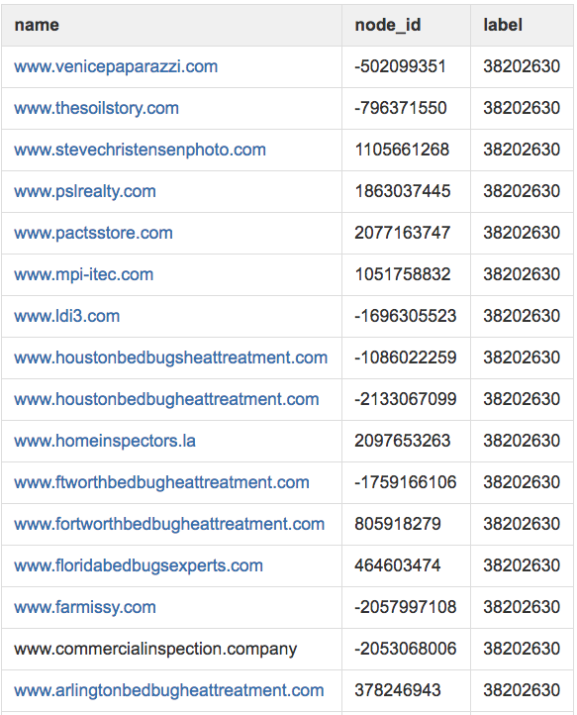
Community: bedbugs
Cookie cutter bedbug sites and sites with similar content resources

Slide 35
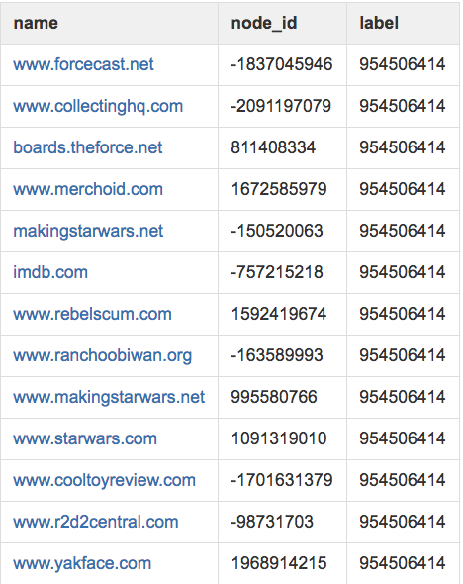
Community: fandoms
Sites related to Star Wars memorabilia

Slide 36
We did this WITHOUT:
Human labelling
Text processing and feature extraction
Domain name feature
A priori number of clusters, cluster size, other metrics

Slide 37
Leveraged only information in the underlying graph structure!

Slide 38
Future Research Ideas
Layer in edge and node attributes (link types, degree, external metadata, etc)
Monitor high degree centrality nodes
Observe how web graphs change over time

Slide 39
Obligatory Summary Slide
Graphs for unsupervised problem-solving.
Why and how community detection works
LPA on large web graphs

Slide 40
I talked about the tip of the iceberg
Didn’t talk about:
Data cleaning
Inconclusive results
Trials and many, many errors ☺
See my Medium posts for more gory detail.

Slide 41
Thanks!
Find me at: wsuen13@gmail.com
Demo: https://github.com/wsuen/pygotham2018_graphmining
Tutorial, part 1: https://medium.com/@wsuen/large-scale-graph-mining-with-spark-750995050656

Slide 42
References
Adamic, Lada A., and Natalie Glance. "The political blogosphere and the 2004 US election: divided they blog." Proceedings of the 3rd international workshop on Link discovery. ACM, 2005. Common Crawl dataset (September 2017). Farine, Damien R., et al. "Both nearest neighbours and long-term affiliates predict individual locations during collective movement in wild baboons." Scientific reports 6 (2016): 27704 Fortunato, Santo. "Community detection in graphs." Physics reports 486.3-5 (2010): 75-174. Girvan, Michelle, and Mark EJ Newman. “Community structure in social and biological networks.” Proceedings of the national academy of sciences 99.12 (2002): 7821–7826. Leskovec, Jure, Anand Rajaraman, and Jeffrey David Ullman. Mining of massive datasets. Cambridge University Press, 2014. Raghavan, Usha Nandini, Réka Albert, and Soundar Kumara. "Near linear time algorithm to detect community structures in large-scale networks." Physical review E 76.3 (2007): 036106. Zachary karate club network dataset -- KONECT, April 2017.

